Slide 1
MERN Stack Development By Elysium Academy
Building Modern Full - Stack Web Applications

Slide 2
What is MERN Stack ?
MERN is a full-stack JavaScript technology stack. Used to build modern web applications. Uses a single programming language across frontend and backend. Supports rapid and scalable application development.
MERN Components:
MongoDB
Express.js
React.js
Node.js

Slide 3
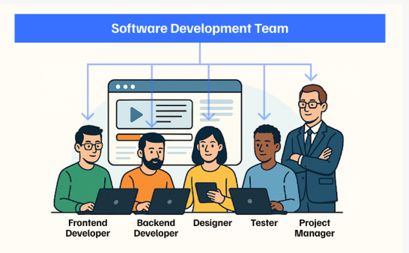

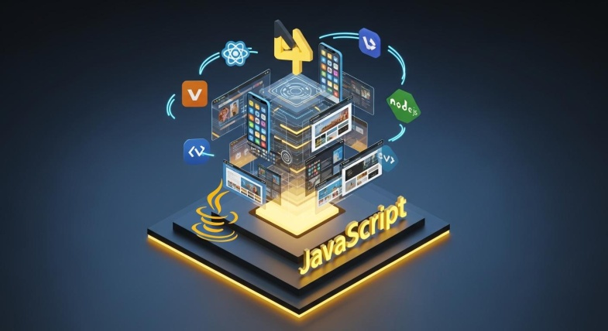
Why MERN Stack ?
Single language (JavaScript) Faster development Reusable code Large community support Scalable applications High performance

Slide 4
MERN Stack Architecture
Frontend → Backend → Database
User → React → Express → Node → MongoDB
User interacts with frontend
Requests processed by backend
Data stored and retrieved from database

Slide 5
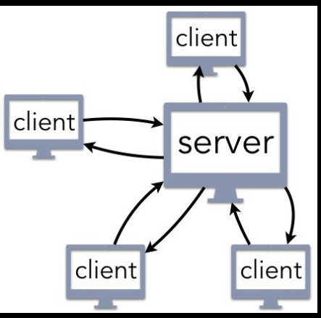
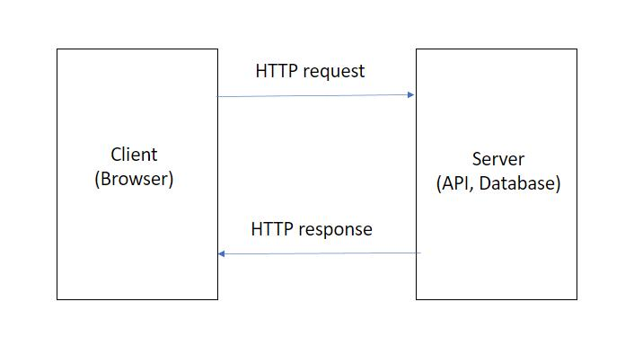
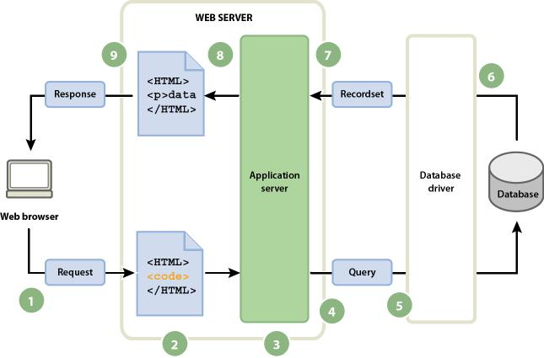
Working Flow of MERN Stack
User sends request
React handles UI
Express receives request
Node processes business logic
MongoDB stores / retrieves data
Response returned to user

Slide 6
Introduction to MongoDB
MongoDB
NoSQL Database
Stores data as documents
JSON-like structure
Flexible schema
Highly scalable

Slide 7
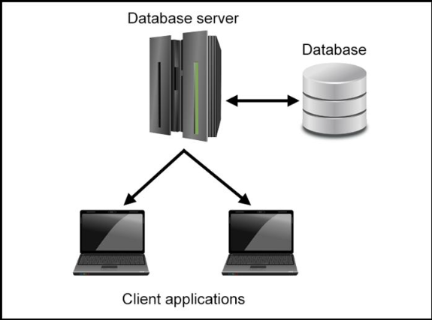
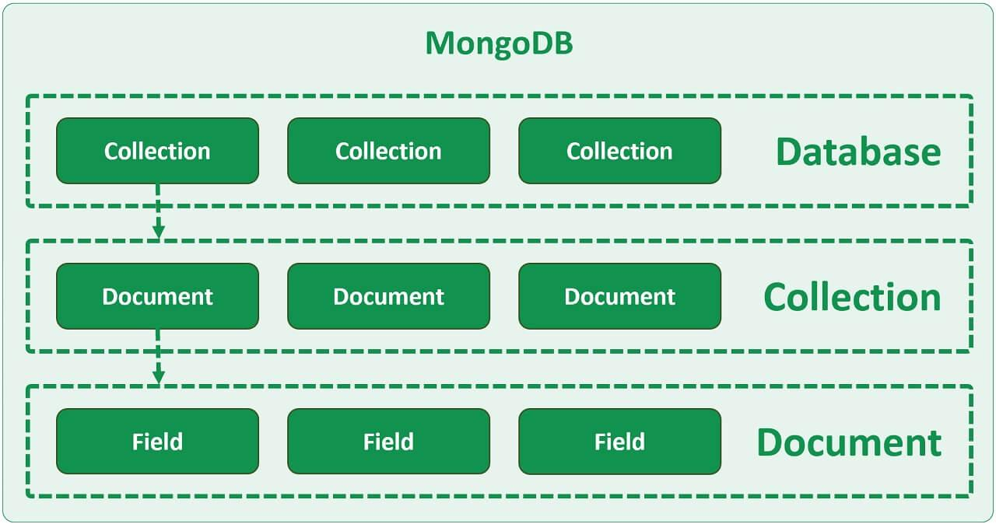
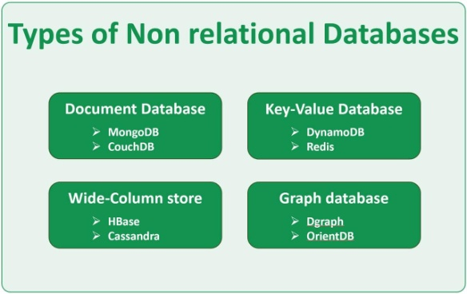
Features of MongoDB
Document-oriented storage
Schema flexibility
High availability
Horizontal scaling
Fast data retrieval

Slide 8
MongoDB Operations
Basic Operations
Create Database
Create Collection
Insert Documents
Query Documents
Update Documents
Delete Documents

Slide 9
Introduction to Express.js
Express.js
Backend framework for Node.js
Simplifies API development
Handles routing
Supports middleware
Lightweight and fast

Slide 10
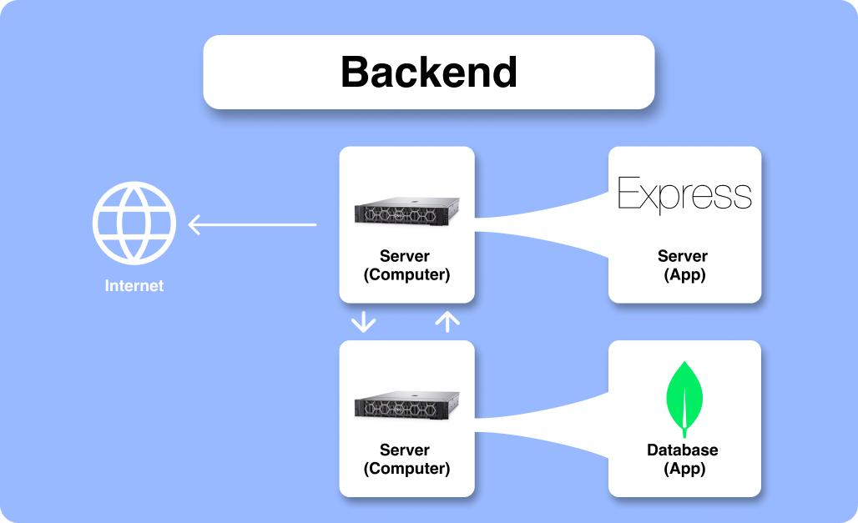

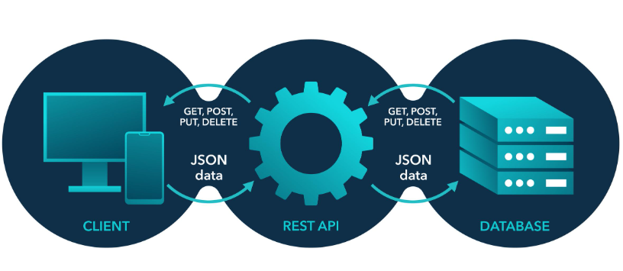
Features of Express.js
Routing support
Middleware integration
REST API development
Error handling
Scalability

Slide 11
What is Middleware ?
Middleware
Functions executed between:
Request → Server → Response
Uses:
Authentication
Logging
Validation
Error Handling

Slide 12
Introduction to Node.js
Node.js
JavaScript Runtime Environment
Executes JavaScript on server
Event-driven architecture
Non-blocking operations

Slide 13

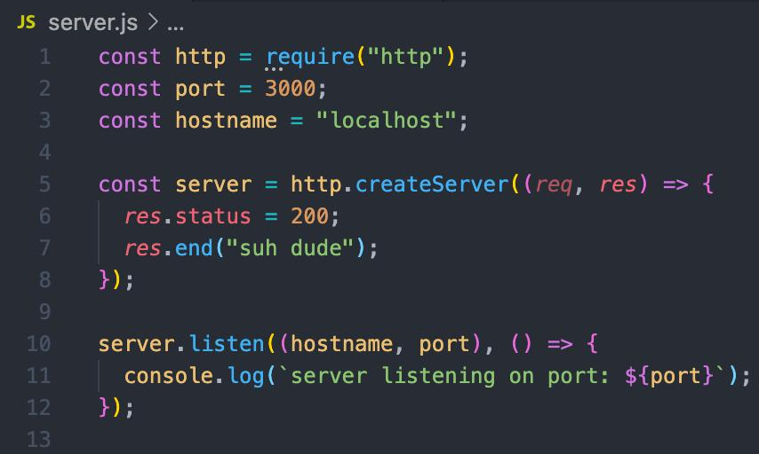
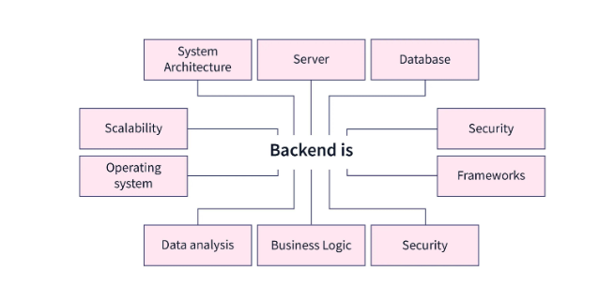
Features of Node.js
Fast execution V8 Engine Asynchronous processing Scalable applications Large package ecosystem

Slide 14
Node.js Event Loop
Event Loop
Handles multiple requests
Non-blocking architecture
Efficient resource utilization
Improves performance

Slide 15

Introduction to React.js
React.js
JavaScript UI Library
Creates dynamic interfaces
Component-based architecture
Used for Single Page Applications

Slide 16

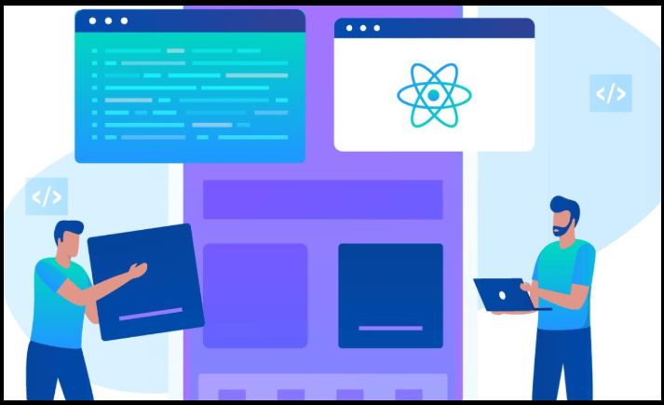
Features of React.js
Virtual DOM
JSX Syntax
Reusable Components
Fast Rendering
State Management

Slide 17
React Components
Types of Components
Functional Components
Class Components
Benefits:
Reusability
Maintainability
Modularity

Slide 18
Virtual DOM Document Object Model
Virtual DOM
Lightweight copy of real DOM
Detects changes efficiently
Improves rendering speed
Better user experience

Slide 19
MERN Development Roadmap
Learn HTML
Learn CSS
Learn JavaScript
Learn React
Learn Node.js
Learn Express.js
Learn MongoDB

Slide 20
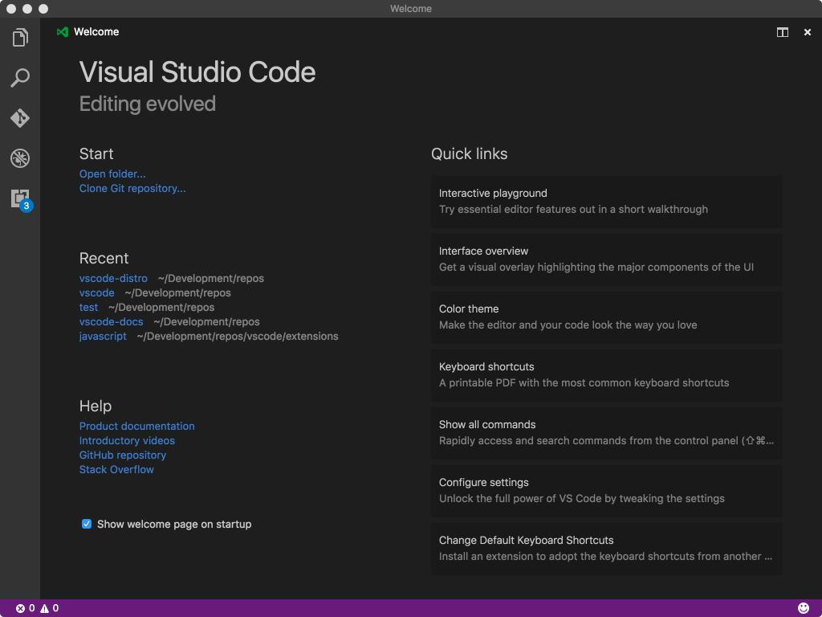


Setting Up Development Environment
Requirements:
Node.js
Code Editor
Browser
MongoDB
Internet Connection

Slide 21
MERN Project Structure
Project │ ├── frontend │ └── React App │ └── backend └── Node + Express

Slide 22
Frontend Responsibilities
React Handles:
UI Design
User Interaction
Form Handling
API Calls
State Management

Slide 23
Backend Responsibilities
Node + Express Handles:
Business Logic
Authentication
Routing
API Development
Data Processing

Slide 24
Database Responsibilities
MongoDB Handles:
Data Storage
Data Retrieval
Data Updates
Data Security
Scalability

Slide 25
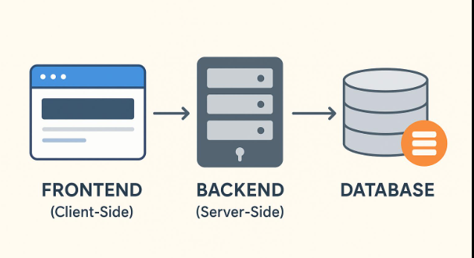
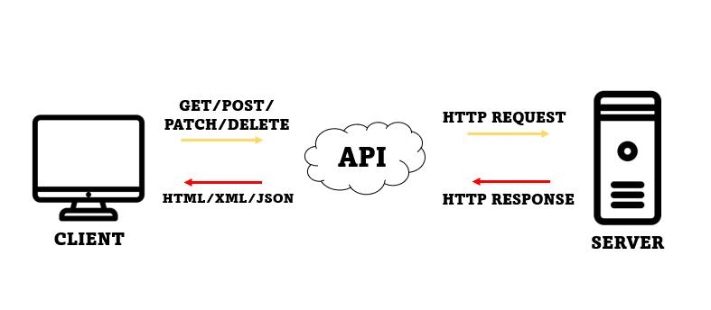
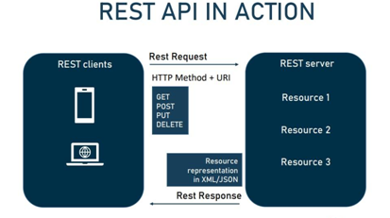
MERN API Communication
Flow
React → API Request
Express → Route Processing
Node → Logic Execution
MongoDB → Database Operations
Response → React

Slide 26
Advantages of MERN Stack
Full-stack JavaScript
Faster Development
Open Source
High Performance
Easy Maintenance
Strong Community Support

Slide 27


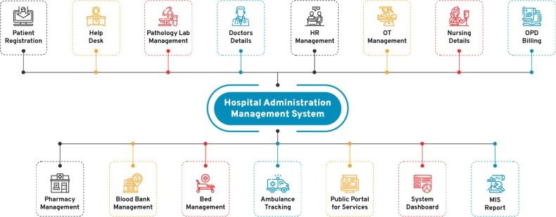
Real - World Applications
MERN Stack is used for:
E-Commerce Platforms
Social Media Apps
Learning Platforms
Hospital Management Systems
Portfolio Applications
Business Dashboards

Slide 28
Challenges in MERN Development
Learning Curve
State Management Complexity
Security Implementation
Performance Optimization
Database Design

Slide 29
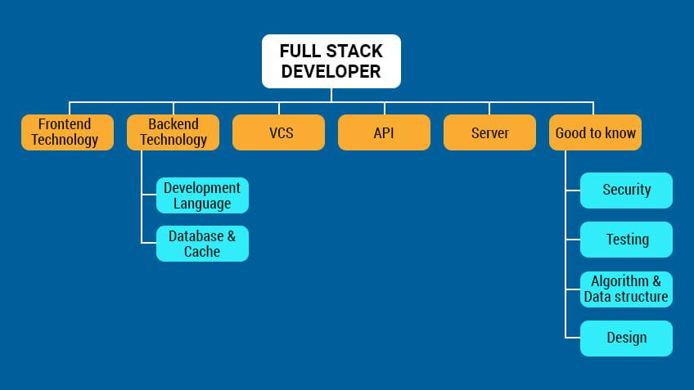


Career Opportunities
MERN Developer
Frontend Developer
Backend Developer
Full Stack Developer
Software Engineer
Web Application Developer

Slide 30
Summary
MERN Stack Recap
✓ MongoDB – Database
✓ Express.js – Backend Framework
✓ React.js – Frontend Library
✓ Node.js – Runtime Environment
Key Takeaway
"One Language, Complete Full-Stack Development"
Source concepts adapted from MERN Stack overview and component descriptions.

Slide 31
References
https://www.google.com/search?q=MERN+Stack+Tutorial&rlz=1C1CHBD_enIN1039IN1039&oq=mern+stack+tutorial&gs_lcrp=EgZjaHJvbWUqBggAEEUYOzIGCAAQRRg7MgcIARAAGIAEMgcIAhAAGIAEMggIAxAAGBYYHjIICAQQABgWGB4yCAgFEAAYFhgeMggIBhAAGBYYHjIICAcQABgWGB4yCAgIEAAYFhgeMggICRAAGBYYHtIBCTcwMDZqMGoxNagCCLACAfEFO0xPI4StHrg&sourceid=chrome&ie=UTF-8
notes Notes NOTES ( Notes 1 To Notes 6 ) - https://github.com/Narthana-Elysium

